Slide 1
hawthorne studies and human relations PGDM Sophitorium Management College

Slide 5
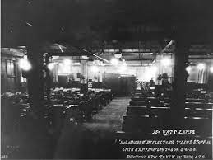

Slide 6
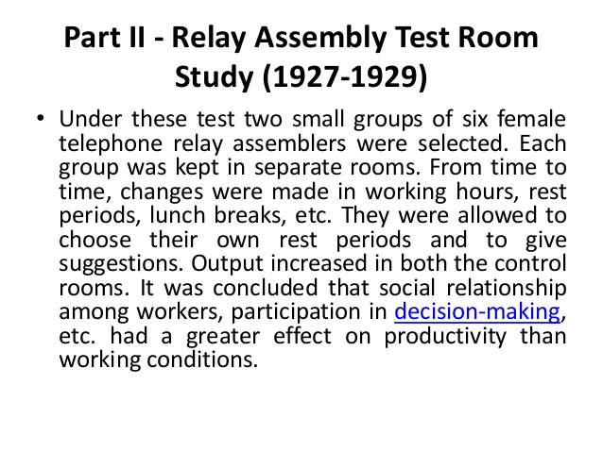

Slide 8
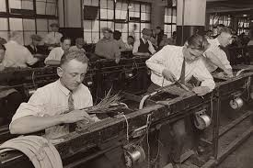

Slide 12
Human Relations Movement
The human relations theory of management began development in the early 1920s. Today, it is integral to every business, and understanding the involved skills and theories is key to employee success.
The human relations movement was founded by sociologist George Elton Mayo in the 1930s following a series of experiments known as the Hawthorne studies,
WHY IS IT IMPORTNANT ?
The human relations movement was a crucial event in management history and a major contribution to today's style of leading.
The behavioral sciences helped managers and theorists understand how to increase productivity by ditching the primary focus on organizations over their workers.

Slide 13
HUMAN RELATION AND ITS SKILLS-1
Definition - as the "study of human problems arising from organizational and interpersonal relations (as an industry).
The 5 human relations skills
Communication
Open lines of communication are essential to any workplace
Effective communication helps ensure that all employees not only are on the same page, but also feel motivated and valued in their work.

Slide 14
HUMAN RELATION AND ITS SKILLS -2
2. Conflict resolution
Managing individuals with differing personality types, worldviews and goals can make universal agreement incredibly difficult, if not impossible, to achieve. Therefore, you must be comfortable and well versed in conflict resolution.
3. Multitasking
A good leader must be able to manage multiple, often competing priorities at once, without missing deadlines.
4. Negotiation
Strong negotiation skills are key to keeping the peace between two parties while reaching an agreement where all parties are satisfied.

Slide 15
Scientific Management
Scientific management says that there is a logic to actions
formal and knowledge authority needed for workplace
The major difference between scientific management and human relations theory was that human relations theory recognized that social factors were a source of power in the workplace
The human relations movement enhanced scientific management because it acknowledged that peoples’ attitudes, perceptions, and desires play a role in their workplace performance.
For example, managers began to realize that settling disputes was more difficult than the scientific management approach described.

Slide 16
Thank you

